Slide 1
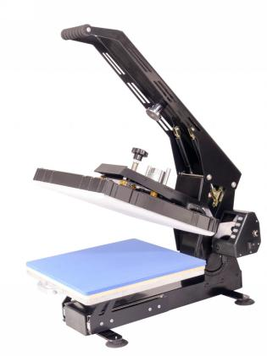


High-end Heat Press Machine Introduction
P3800

Slide 2
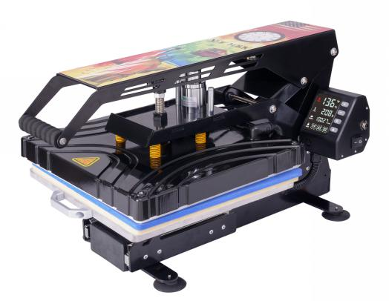
CONTENTS PAGE
01
Heat press machine profile
02
Details introduction
03
Package introduction

Slide 3
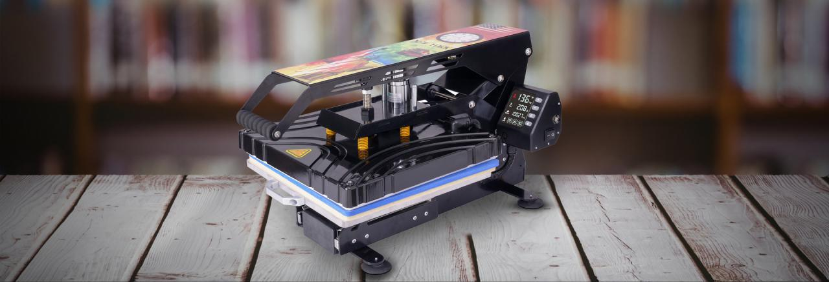

1
Heat press machine profile
PART ONE

Slide 4







Introduction
P3800（High-end heat press machine）
This model is designed for high-end professional heat press machine. It adopts double tube solid aluminum heating plate. Heavy pulling-type rail, can cover the T-shirt front and back. It has automatic bounce function. The whole machine frame adopts 3mm thickness metal, some parts have 4mm thickness. With the mould spring, to make the pressure uniform and heating even

Slide 5
2
Details introduction
PART TWO

Slide 6
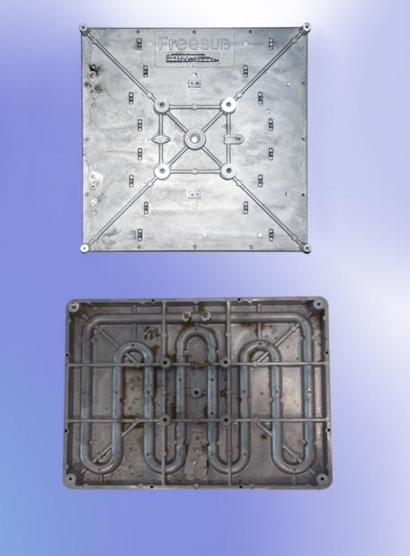
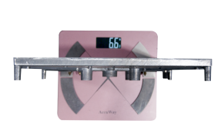
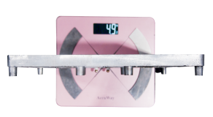
Double heating tube
It's heating more even and can make the printing effect better through the double heating tube design, as the temperature difference is only about 5 degrees from the Central and the edge,and the old machine design difference can be 10 more degrees.It's heating more even and can make the printing effect better through the double heating tube design, as the temperature difference is only about 5 degrees from the Central and the edge,and the old machine design difference can be 10 more degrees.
Double heating tube
New machine:double heating tube
Weight：6.6kg
Old machine:single heating tube
Weight：4.9kg
Single heating tube

Slide 7
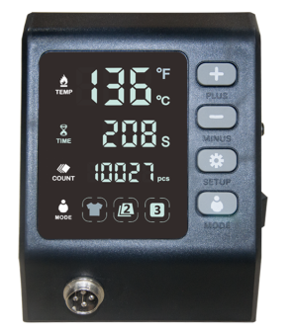
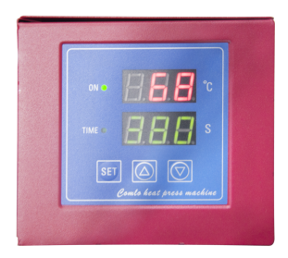
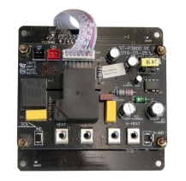
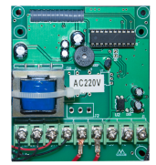
Controller comparison
P3800 controller
Old model 38*38
P3800 mainboard
38*38 mainboard
1: Using 30A high power relay temperature control, can count the number of production
2: 3 modes are free to switch,can quickly make different products
Large screen display, all kinds of parameters at a glance
3: Silicone button, good feeling and high sensitivity
It is impossible to count the number of productions, the parameter display is single, the button operation is cumbersome, and the sensitivity is low.

Slide 8
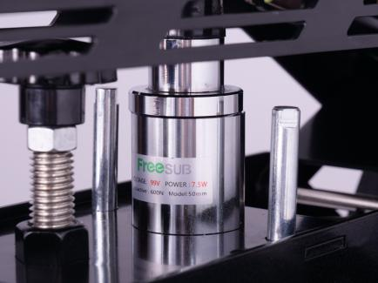
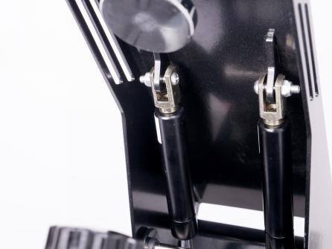
Automatic bounce function
With the electromagnet, when time reach, can automatic open
Two car hydraulic rods , smooth bounce, safe and labor-saving

Slide 9
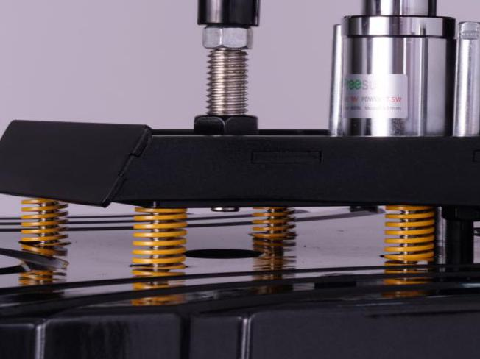
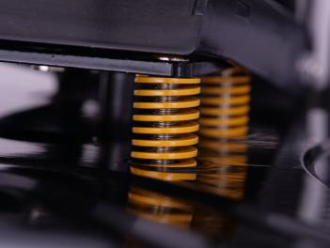
Mould Spring
More uniform pressure with mould
springs

Slide 10
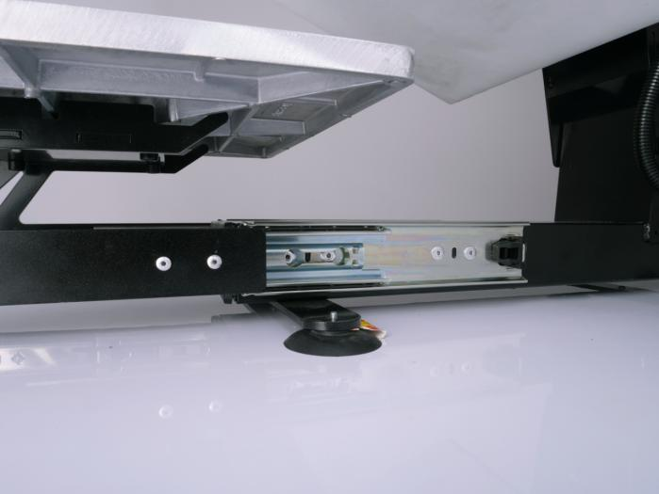
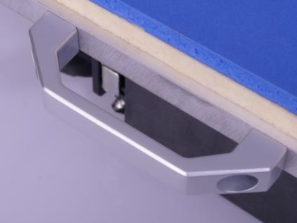
Heavy duty rail
Heavy duty rail ，Drawer design, load-bearing 100KG, detachable rails, can cover the T-shirt on the front and back.

Slide 11
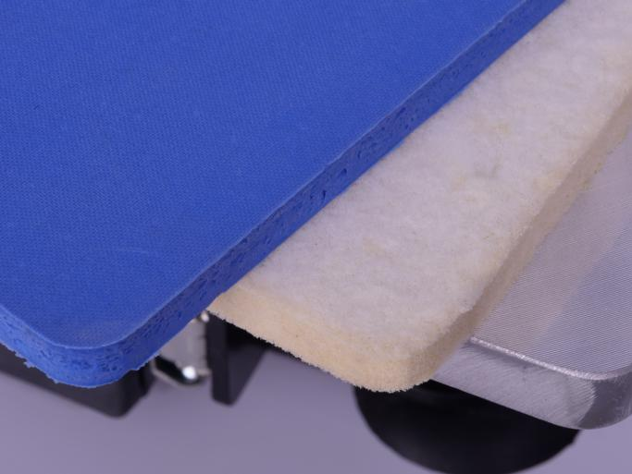
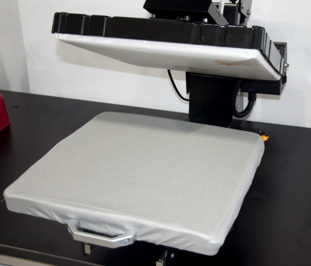
Aluminum alloy down plate
The down plate use aluminum ally, flat and not deformed.
When delivery, the down plate covers with the Teflon cloth to keep the heating plate clean and tidy

Slide 12
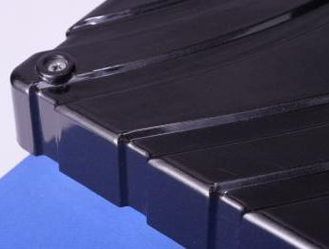
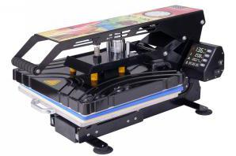
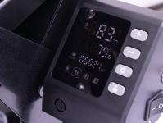
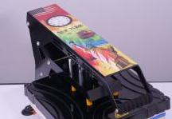
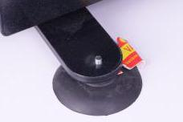
More details
1、 Anti-scalding plastic cover
2、 Silicone button feels sensitive
3、 Suction foot keep machine stable
4、Down plate covers with Teflon cloth
5、 The whole machine adopts a 3mm thick metal frame
6、 Individual aluminum plate decoration
Anti-scalding plastic cover
Silicon button
Individual aluminum plate decoration
suction foot
3mm thick metal frame

Slide 13
3
Package introduction
PART THREE

Slide 14
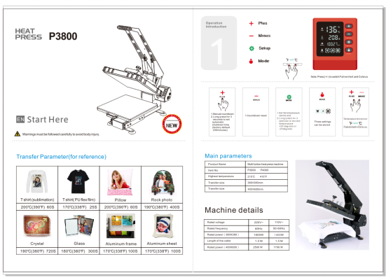
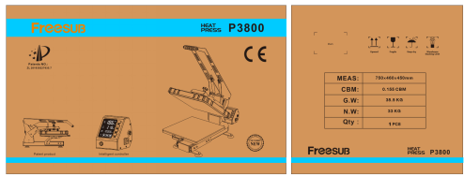
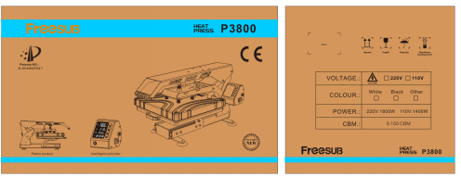
Package details
7-layer carton packs with thick foam protection
Using 7-layer carton, customizable LOGO
Introduction

Slide 15

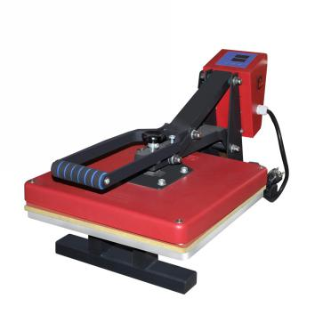
New and old machine comparison
From the appearance, function, quality of the new and the old machine contrast, the new machine is obviously stronger than the old machine, the new machine price is also affordable, the price difference is not big.
New model P3800
Old model 38*38

Slide 16


